Slide 1
Capstone Engagement
Assessment, Analysis, and Hardening of a Vulnerable System
By Jeff Burnside

Slide 2
Table of Contents
This document contains the following sections:
01
Network Topology
02
Red Team: Security Assessment
03
Blue Team: Log Analysis and Attack Characterization
Hardening: Proposed Alarms and Mitigation Strategies
04

Slide 3
Network Topology
‹#›

Slide 4
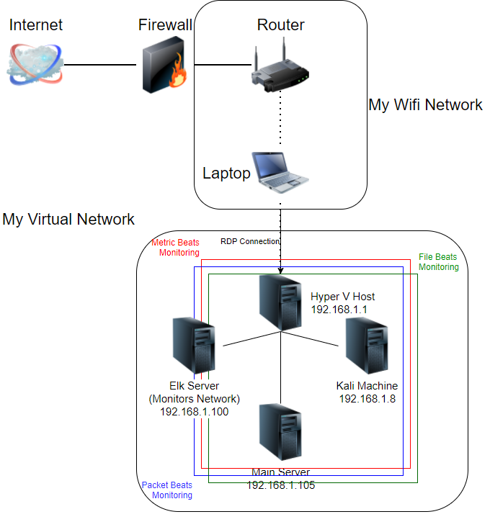
Network Topology
Network
Address Range: 192.168.1.0/24
Netmask: 255.255.255.0
Gateway: 0.0.0.0
Machines
IPv4:192.168.1.1
OS: Windows 10
Hostname: Hyper-V Host
IPv4:192.168.1.100
OS: Windows 10
Hostname: Elk Server
IPv4: 192.168.1.105
OS: Ubuntu
Hostname: Main Server
IPv4: 192.168.1.8
OS: Kali Linux
Hostname: Kali Machine

Slide 5

Red Team
Security Assessment
‹#›

Slide 6
Recon: Describing the Target
Nmap identified the following hosts on the network:
Hostname | IP Address | Role on Network
Hyper-V Host | 192.168.1.1 | Holds all the the VM’s all on one network.
Elk Server | 192.168.1.100 | A backdoor Server that monitors and logs activities happening on the network.
Main Server | 192.168.1.105 | The main server that has all the data for the company.
Kali Machine | 192.168.1.8 | This is the kali machine used to perform the attacks on the servers.

Slide 7
Vulnerability Assessment
The assessment uncovered the following critical vulnerabilities in the target:
Vulnerability | Description | Impact
Nmap: Open port vulnerability | Nmap scanned the whole network for each machine and looked for any open ports. | This shows open ports for the attacker to try to connect to.
Password based-login: Brute force | Brute force allowed us to use a wordlist to find the password on a hidden company folder. | Brute force attack allowed the attacker to keep trying to log in to access the secret folder.
URL Directory Code indexing | Being able to navigate in the server just by changing the URL directory on top. | The attacker can easily navigate by the URL bar on top through folders and directories.
Remote command execution | A reverse shell was used to obtain an interactive shell session on the target machine to continue their attack. | The attacker was able to remote into the main server to collect the data they desired.

Slide 8
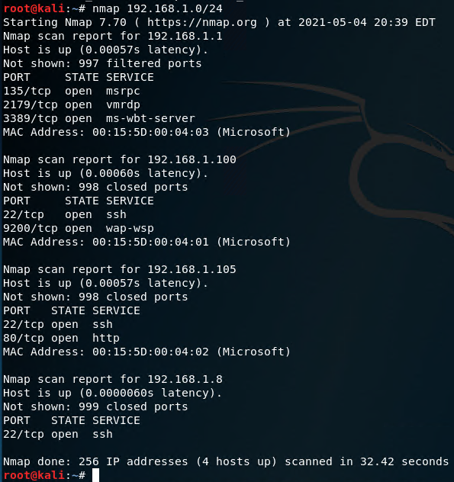
Open Port Vulnerability
01
02
03
Tools & Processes
Nmap was use to scan the whole network for information on each computer on it and for any ports that might be open.
Achievements
It showed each each servers IP Address and showed all open ports on each machine.

Slide 9
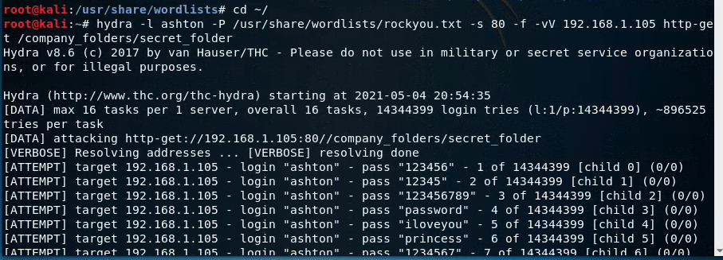
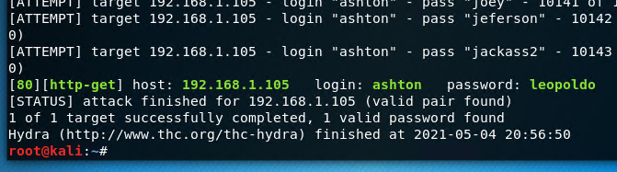
Password Based-Login
01
02
03
Tools & Processes
Using a brute force attack, the attacker used Hydra with a wordlist to try to access to the company’s secret folder.
Achievements
Hydra was able to use the wordlist of thousands of passwords against a login page to finally gain access to the company’s server.

Slide 10
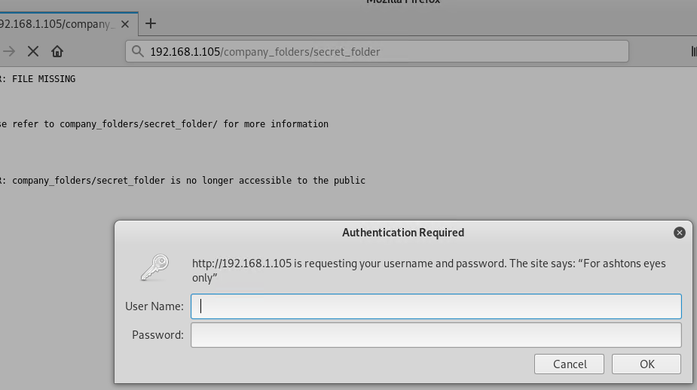
URL Directory Code Indexting
01
02
03
Tools & Processes
No tools needed for this. It is easily being able to type in the URL bar what directory and folders you want to go to.
Achievements
The attacker was able to type in the path to the secret folder they were trying to access.

Slide 11
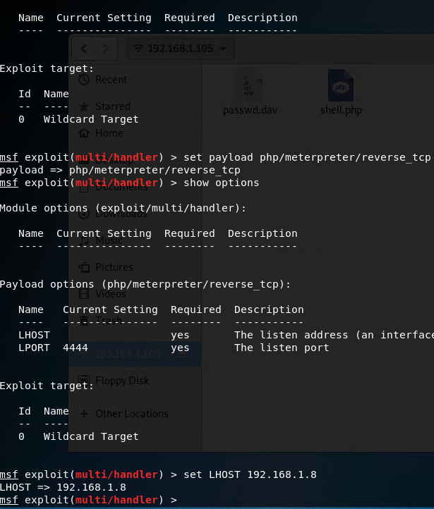
Remote Command Execution
01
02
03
Tools & Processes
A reverse shell was used to obtain an interactive shell session on the target machine. For this metasploit was used to execute the attack.
Achievements
The attacker was able to remote into the main server and access the data required.

Slide 12

Blue Team
Log Analysis and Attack Characterization
‹#›

Slide 13

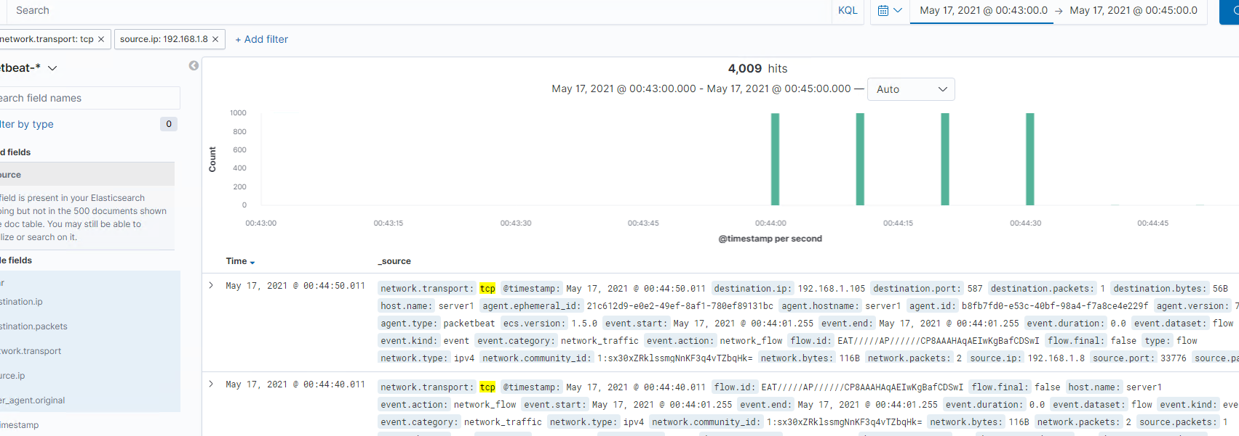
Analysis: Identifying the Port Scan
What time did the port scan occur?
How many packets were sent, and from which IP?
What indicates that this was a port scan?
May 17th at 12:44 am
4,009 from IP address 192.168.1.8
Capturing the packets and the TCP handshake being sent out from the attacking computer.

Slide 14
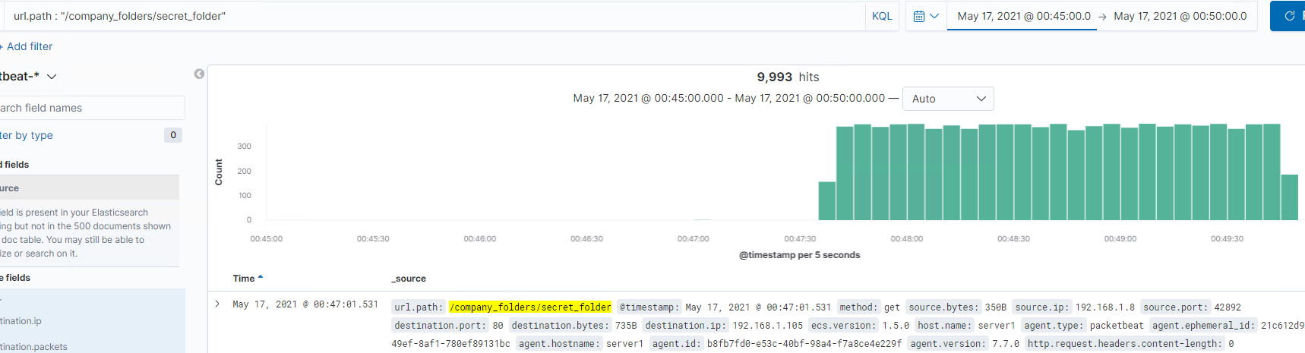
Analysis: Finding the Request for the Hidden Directory
What time did the request occur? How many requests were made?
Which files were requested? What did they contain?
12:47am. The folder was hit 9,993 times.
They were trying to get access to the folder’s contents. Access to the server via Webdav.

Slide 15
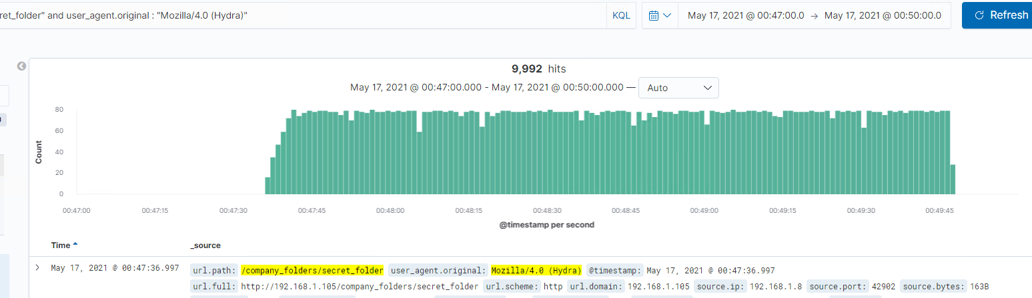
Analysis: Uncovering the Brute Force Attack
How many requests were made in the attack?
How many requests had been made before the attacker discovered the password?
9,992 hits.
9,991 hits and the last one was the discovery of the actual password.

Slide 16
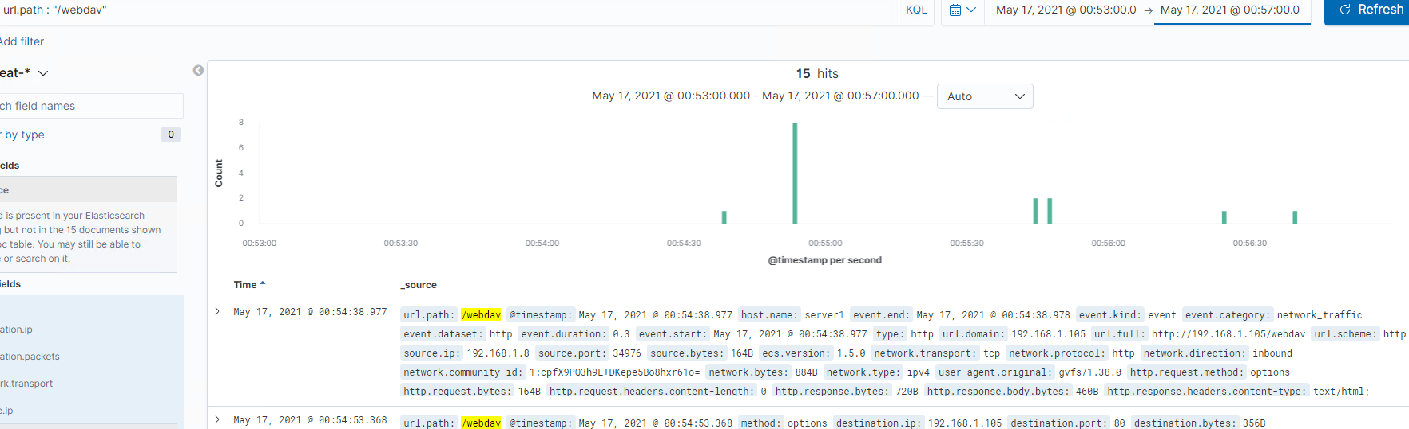
Analysis: Finding the WebDAV Connection
How many requests were made to this directory?
Which files were requested?
15 hits were taken against the WebDav connection
It was requesting for passwords for connection for the server.

Slide 17
Blue Team
Proposed Alarms and Mitigation Strategies
‹#›

Slide 18
Mitigation: Blocking the Port Scan
To set alarms for this in the future you’ll want to set an alert for a high amount of ping request being sent to a machine to send an email to someone to take care of at once
For the threshold you’ll want to set an alert for no more than 10 requests in a 5 minute period.
Have a firewall set up to block any activity or request to your network. Have it set up to block any internet activity when the machines on the system are not in use.

Slide 19
Mitigation: Finding the Request for the Hidden Directory
You would want to set an alarm for an amount of failed attempts at access this folder would result in a lock out and to contact your admin.
Set a threshold for no more than 3 failed attempts will send an will send an alert to take care of at once.
To this directory you can have a limit of 3 attempted logins to lock out the user to contact the admin to let you back in.
To really enforce that directory just block all password access and only allow from specific IP Address access.

Slide 20
Mitigation: Preventing Brute Force Attacks
For this was an attack to trying to log in using hydra. You’ll want to set an alert for an amount of failed logins would have an alert sent out
For this you’ll want to set a threshold of more than 3 attempts to send an alert out.
For preventing brute force attacks can be multiple things to set to the server to prevent this from happening again.
Limit no more than 3 login attempts.
Use CAPTCHA’s
Two factor authentications
Strong passwords
Allow access from specific URL’s or IP Addresses to the server.

Slide 21
Mitigation: Detecting the WebDAV Connection
This alarm you’ll want to set up for any get requests done to this directory you’ll want to look out for.
You’ll want to set up a threshold for no more than “0” requests done to this directory will send an alert to someone.
For this solution you’ll want to monitor any ip address accessing this directory and only allow very small amount of IP Addresses

Slide 22
Mitigation: Identifying Reverse Shell Uploads
What kind of alarm can be set to detect future file uploads? To set an alarm for this certain attack will be for any POST requests and PUT requests done to your main server will send out an alert.
For a threshold on this i would say for any executable being uploaded should send an alert to someone.
To prevent reverse shells from happening in future would be to block all outgoing connectivity and only allow specific IP Addresses and ports to for the required access.

